Slide 1


“COFFEE VENDING SYSTEM”
Task - 1

Slide 2


Username | Name
2105a3453 | Nithya priya.J
2105a3572 | Sindhu.S
2105a3580 | Varsha.M

Slide 3
Objective:
An automated machine which is intended to provide the users with a diverse range of products: snacks, beverages, pizzas, cupcakes, newspapers, tickets, etc. A vending machine dispenses a product to the users based on the amount of money inserted and selection of the product.
Scope:
The global market for Vending Machines estimated at US$134.4 Billion in the year 2020, is projected to reach a revised size of US$146.6 Billion by 2027, growing at a CAGR of 1.3% over the analysis period 2020-2027.

Slide 4
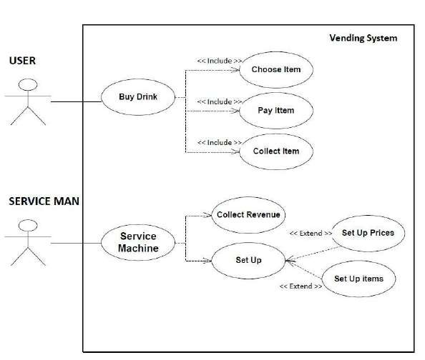
Use Case Diagram:

Slide 5

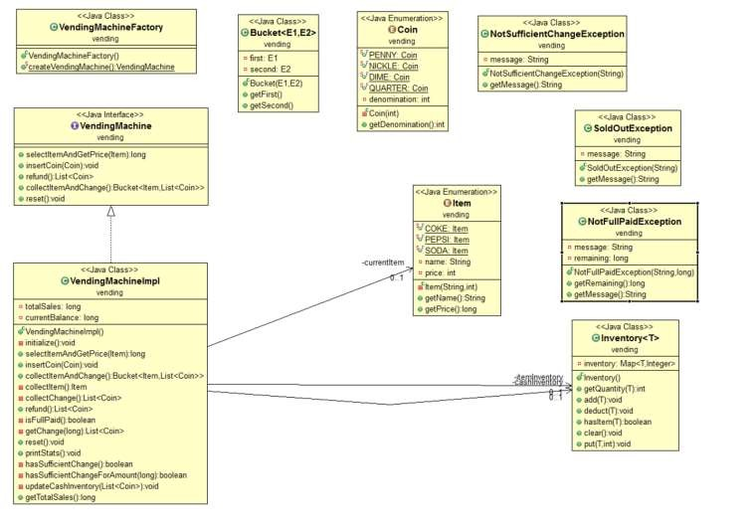

Class diagram:
Summary of your task

Slide 6
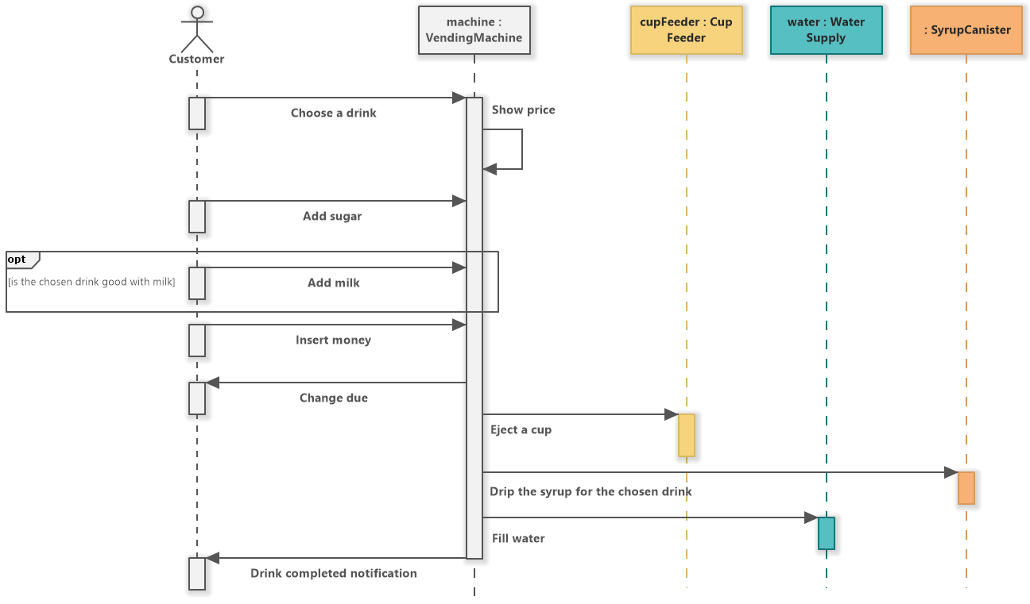
Sequence Diagram:

Slide 7
Step-Wise Description:
DOUBLE OPTION PREMIX VENDING MACHINE
They are the most common and most popular premix machines available in the market. Since theycan dispense two beverages; thus, they are called double option Premix Vending Machine.
TRIPLE OPTION VENDING MACHINES
As the name suggests, Triple Option Vending Machines are those who can dispense three
beverages. They are not that budget-friendly so not that popular among the offices/canteens.
QUADRA OPTION PREMIX VENDING MACHINE
After Two-Lane Machine, these machines are more common and popular among the people.
They are somewhat the same in size as Triple option and can dispense four beverages.
COIN OPERATED VENDING MACHINES
These machines are basically Triple Option machines with coin-operated facilities and two beverages. They are entirely commercial

Slide 8
SINGLE PORTABLE PREMIX VENDING MACHINES
They are the least relevant in the current market scenario. Since they are mainly manufactured for home use, you won’t be able to cater to an Office/ College Canteen/ Retail Outlet etc.
They are not common, so they are manufactured very less in numbers and are mostly
out of stock.
Functional Requirements:
Business requirements. They contain the ultimate goal, such as an order system, an online catalogue, or a physical product. It can also include things like approval workflows and authorization levels.
Administrative functions. They are the routine things the system will do, such as reporting.
User requirements. They are what the user of the system can do, such as place an order or browse the online catalogue.
System requirements. These are things like software and hardware
specifications, system responses, or system actions.

Slide 9


Non-functional Requirements:
Usability. This focuses on the appearance of the user interface and how people interact with it.
What colour are the screens? How big are the buttons?
Reliability / Availability. What are the uptime requirements? Does it need to function 24/7/365?
Scalability. As needs grow, can the system handle it? For physical installations, this includes spare
hardware or space to install it in the future.
Performance. How fast does it need to operate?
Supportability. Is support provided in-house or is remote accessibility for external resources
required?
Security. What are the security requirements, both for the physical installation and from a cyber
perspective?

Slide 10

Summary of the Task:
The designed vending machine prototype was successfully implemented using FPGA as its main controller. It is equipped with interactive user interface system that eliminates the uses of push buttons. In conclusion, the project has achieved all the proposed objectives to improve the overall performance of the vending machine on terms of cost saving, attractiveness, reliability, and not easily damaged by vandalism activities.

Slide 11
Reference:
Poon, T. C., Choy, K. L., Cheng, C. K. and Lao, S. I. A Real-Time Replenishment System for Vending Machine Industry.Proceedings of the2010 IEEE Industrial Informatics.July 13-16, 2010. Osaka: IEEE, 209 –213.
Yokouchi, T. Today and tomorrow of vending machine and its services in Japan. Proceedings of the 2010 IEEE
Service Systems and Service Management.June 28-30, 2010. Tokyo: IEEE, 1-5.
Buck, A. J., Hakim, S., Swamson, C. and Rattner, A. Vandalism of Vending Machines: Factors That Attract Professionals and Amateurs. Proc. Journal of Criminal Justice, 2003. 31: 85-95.
Hornby, A. S. Oxford Advanced Learner’s Dictionary.5th. ed. New York: Oxford University Press. 1995.

Slide 12


https://github.com/12ssind/curly-lamp
Submission Github

Slide 13


